Slide 1
Network Devices (Hub, Repeater, Bridge, Switch, Router and Gateways)

Slide 2
Hub
A hub is a physical layer networking device which is used to connect multiple devices in a network. They are generally used to connect computers in a LAN.
A hub has many ports in it. A computer which intends to be connected to the network is plugged in to one of these ports. When a data frame arrives at a port, it is broadcast to every other port, without considering whether it is destined for a particular destination or not.
hub can be used with both digital and analog data. Hubs do not perform packet filtering or addressing function, they send the data packets to all the connected devices.
Types of Hub −
Active Hub
Passive Hub
Intelligent Hub

Slide 3
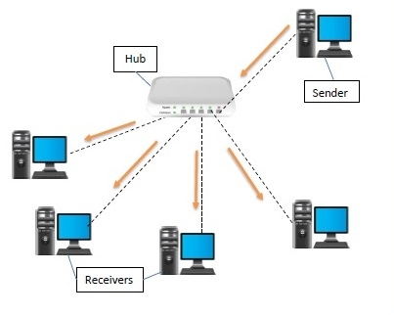

Slide 4
Repeater
A repeater operates at the physical layer of the OSI model.
A Repeater connects two segments of a network cable.
Sometimes it regenerates the signals to proper amplitudes and sends them to the other segment.
If the signal becomes weak, it can copy the signal bit by bit and regenerate it at the original strength.
It is a 2-port device.
Bridge
A bridge operates at the data link layer of the OSI model.
It can read only the outmost hardware address of the packet but cannot read the IP address.
It reads the outmost section of the data packet to tell where the message is going. It reduces the traffic on other network segments.
It does not send all the packets. So, a bridge can be programmed to reject packets from a particular network.

Slide 5
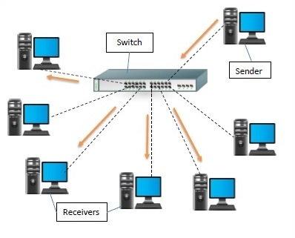
Switch
A switch is a data link layer networking device which connects devices in a network.
Uses packet switching to send and receive data over the network.
Like a hub, a switch also has many ports, to which computers are plugged in.
However, when a data frame arrives at any port of a network switch, it examines the destination address and sends the frame to the corresponding device(s).
Thus, it supports both unicast and multicast communications.

Slide 6
Differences between Hub and Switch
Hub | Switch
They operate in the physical layer of the OSI model. | They operate in the data link layer of the OSI model.
It is a non-intelligent network device that sends message to all ports. | It is an intelligent network device that sends message to selected destination ports.
It primarily broadcasts messages. | It is supports unicast, multicast and broadcast.
Transmission mode is half duplex. | Transmission mode is full duplex.
Collisions may occurs during setup of transmission when more than one computers place data simultaneously in the corresponding ports. | Collisions do not occur since the communication is full duplex.
They are passive devices; they don’t have any software associated with it. | They are active devices, equipped with network software.
They generally have fewer ports of 4/12. | The number of ports is higher – 24/48.

Slide 7
Router
Routers are small physical devices that operate at the network layer to join multiple networks together.
A router is a device like a switch that routes data packets based on their IP addresses.
Routers normally connect LANs and WANs and have a dynamically updating routing table based on which they make decisions on routing the data packets.
A Router divides the broadcast domains of hosts connected through it.
Routers perform the traffic directing functions on the Internet. A data packet is typically forwarded from one router to another through the networks that constitute the internetwork until it reaches its destination code.
Routers may also be used to connect two or more logical groups of computer devices known as subnets, each with a different subnetwork address. The subnet addresses recorded in a router do not necessarily map directly to the physical interface connections.

Slide 8
Two types of routers −
Static routers – Static routers are configured manually and route data packets based on the information in a router table.
Dynamic routers – Dynamic routers use adaptive routing which is a process where a router can forward data by a different route.
Gateway
A gateway is an internetworking capable of joining together two networks that use different base protocols.
A network gateway can be implemented completely in software, hardware, or a combination of both, depending on the types of protocols they support.
A network gateway can operate at any level of the OSI model. A broadband router typically serves as the network gateway, although ordinary computers can also be configured to perform equivalent functions.
A gateway is a router or proxy server that routes between networks.
A gateway belongs to the same subnet to which the PC belongs.

